Slide 1
DATA SCIENCE CAPSTONE PROJECT
YASIN SINAN
10 JANUARY 2026

Slide 2
OUTLINE
EXECUTIVE SUMMARY
INTRODUCTION
METHODOLOGY
RESULT
CONCLUSION
APPENDIX

Slide 3
EXECUTIVE SUMMARY
Collected data from public SpaceX API and SpaceX Wikipedia page. Created labels column ‘class’ which classifies successful landings. Explored data using SQL, visualization, folium maps, and dashboards. Gathered relevant columns to be used as features. Changed all categorical variables to binary using one hot encoding. Standardized data and used GridSearchCV to find best parameters for machine learning models. Visualize accuracy score of all models.
Four machine learning models were produced: Logistic Regression, Support Vector Machine, Decision Tree Classifier, and K Nearest Neighbors. All produced similar results with accuracy rate of about 83.33%. All models over predicted successful landings. More data is needed for better model determination and accuracy.,

Slide 4
Introduction
Background: • Commercial Space Age is Here • Space X has best pricing ($62 million vs. $165 million USD) • Largely due to ability to recover part of rocket (Stage 1) • Space Y wants to compete with Space X
Problem: • Space Y tasks us to train a machine learning model to predict successful Stage 1 recovery

Slide 5
Methodology
• Data collection methodology:
• Combined data from SpaceX public API and SpaceX Wikipedia page
• Perform data wrangling
• Classifying true landings as successful and unsuccessful otherwise
• Perform exploratory data analysis (EDA) using visualization and SQL
• Perform interactive visual analytics using Folium and Plotly Dash
• Perform predictive analysis using classification models
• Tuned models using GridSearchCV

Slide 6
Data Collection Overview
verview 7 Data collection process involved a combination of API requests from Space X public API and web scraping data from a table in Space X’s Wikipedia entry. The next slide will show the flowchart of data collection from API and the one after will show the flowchart of data collection from webscraping. Space X API Data Columns: FlightNumber, Date, BoosterVersion, PayloadMass, Orbit, LaunchSite, Outcome, Flights, GridFins, Reused, Legs, LandingPad, Block, ReusedCount, Serial, Longitude, Latitude Wikipedia Webscrape Data Columns: Flight No., Launch site, Payload, PayloadMass, Orbit, Customer, Launch outcome, Version Booster, Booster landing, Date, Time

Slide 7
Data Wrangling
Create a training label with landing outcomes where successful = 1 & failure = 0. Outcome column has two components: ‘Mission Outcome’ ‘Landing Location’ New training label column ‘class’ with a value of 1 if ‘Mission Outcome’ is True and 0 otherwise. Value Mapping: True ASDS, True RTLS, & True Ocean – set to -> 1 None None, False ASDS, None ASDS, False Ocean, False RTLS – set to -> 0

Slide 8
EDA with Data Visualization
Exploratory Data Analysis performed on variables Flight Number, Payload Mass, Launch Site, Orbit, Class and Year. Plots Used: Flight Number vs. Payload Mass, Flight Number vs. Launch Site, Payload Mass vs. Launch Site, Orbit vs. Success Rate, Flight Number vs. Orbit, Payload vs Orbit, and Success Yearly Trend Scatter plots, line charts, and bar plots were used to compare relationships between variables to decide if a relationship exists so that they could be used in training the machine learning model

Slide 9
EDA with SQL
Loaded data set into IBM DB2 Database. Queried using SQL Python integration. Queries were made to get a better understanding of the dataset. Queried information about launch site names, mission outcomes, various pay load sizes of customers and booster versions, and landing outcomes

Slide 10
Build an interactive map with Folium
Folium maps mark Launch Sites, successful and unsuccessful landings, and a proximity example to key locations: Railway, Highway, Coast, and City. This allows us to understand why launch sites may be located where they are. Also visualizes successful landings relative to location.

Slide 11
Build a Dashboard with Plotly Dash
Dashboard includes a pie chart and a scatter plot. Pie chart can be selected to show distribution of successful landings across all launch sites and can be selected to show individual launch site success rates. Scatter plot takes two inputs: All sites or individual site and payload mass on a slider between 0 and 10000 kg. The pie chart is used to visualize launch site success rate. The scatter plot can help us see how success varies across launch sites, payload mass, and booster version category.

Slide 12
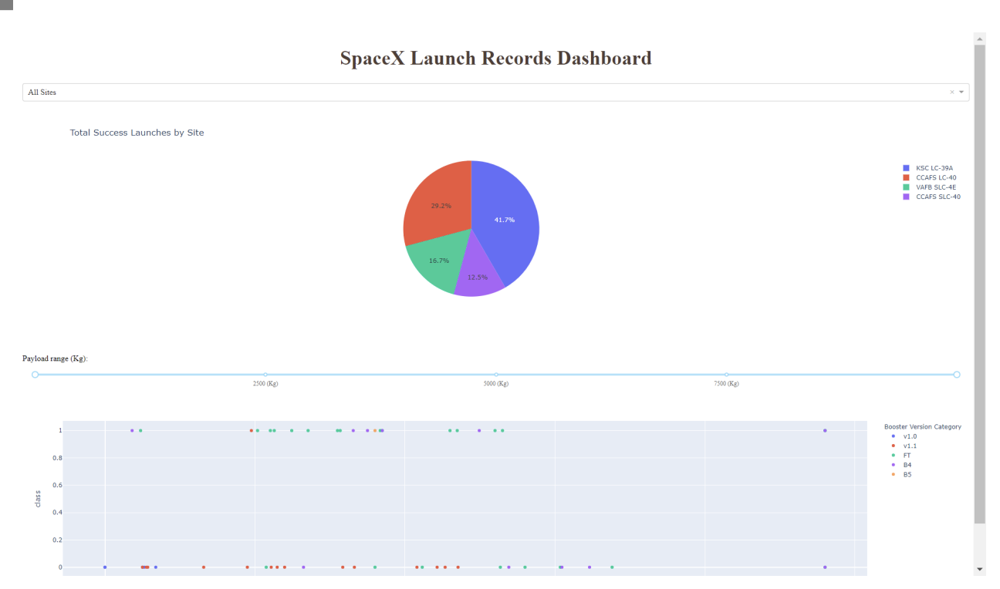
Predictive analysis (Classification)
This is a preview of the Plotly dashboard. The following sides will show the results of EDA with visualization, EDA with SQL, Interactive Map with Folium, and finally the results of our model with about 83% accuracy.

Slide 13
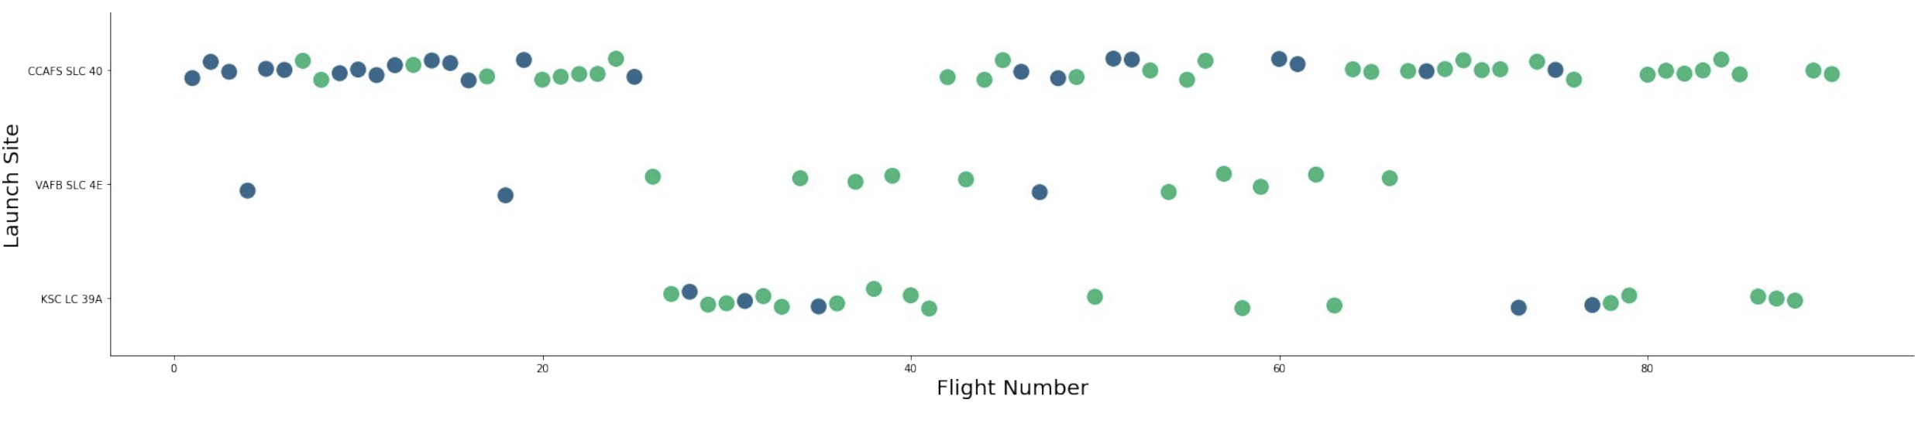
E D A with Visualization
Visualization 17 EXPLORATORY DATA ANALYSIS WITH SEABORN PLOTS
Flight Number vs. Launch Site
Green indicates successful launch; Purple indicates unsuccessful launch

Slide 14
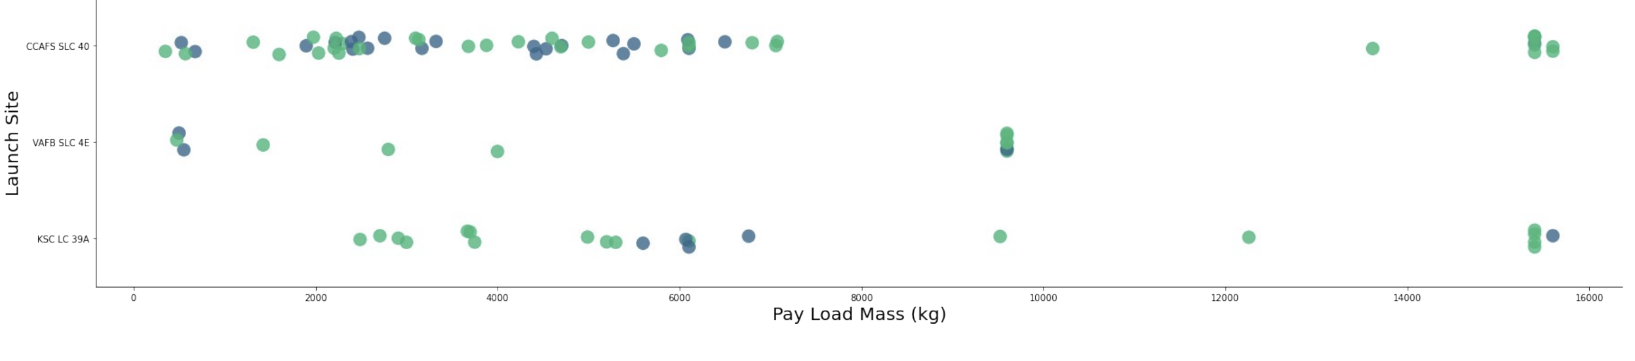
Payload vs. Launch Site
Green indicates successful launch; Purple indicates unsuccessful launch.

Slide 15
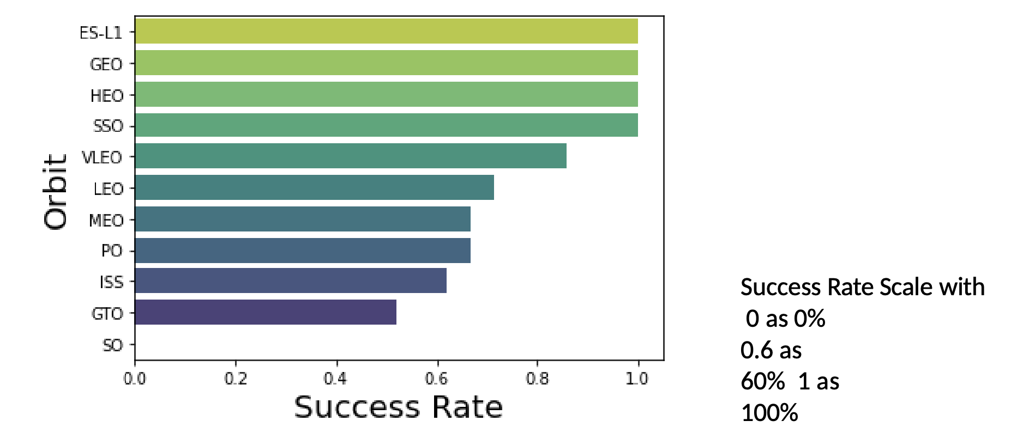
Success rate vs. Orbit type

Slide 16
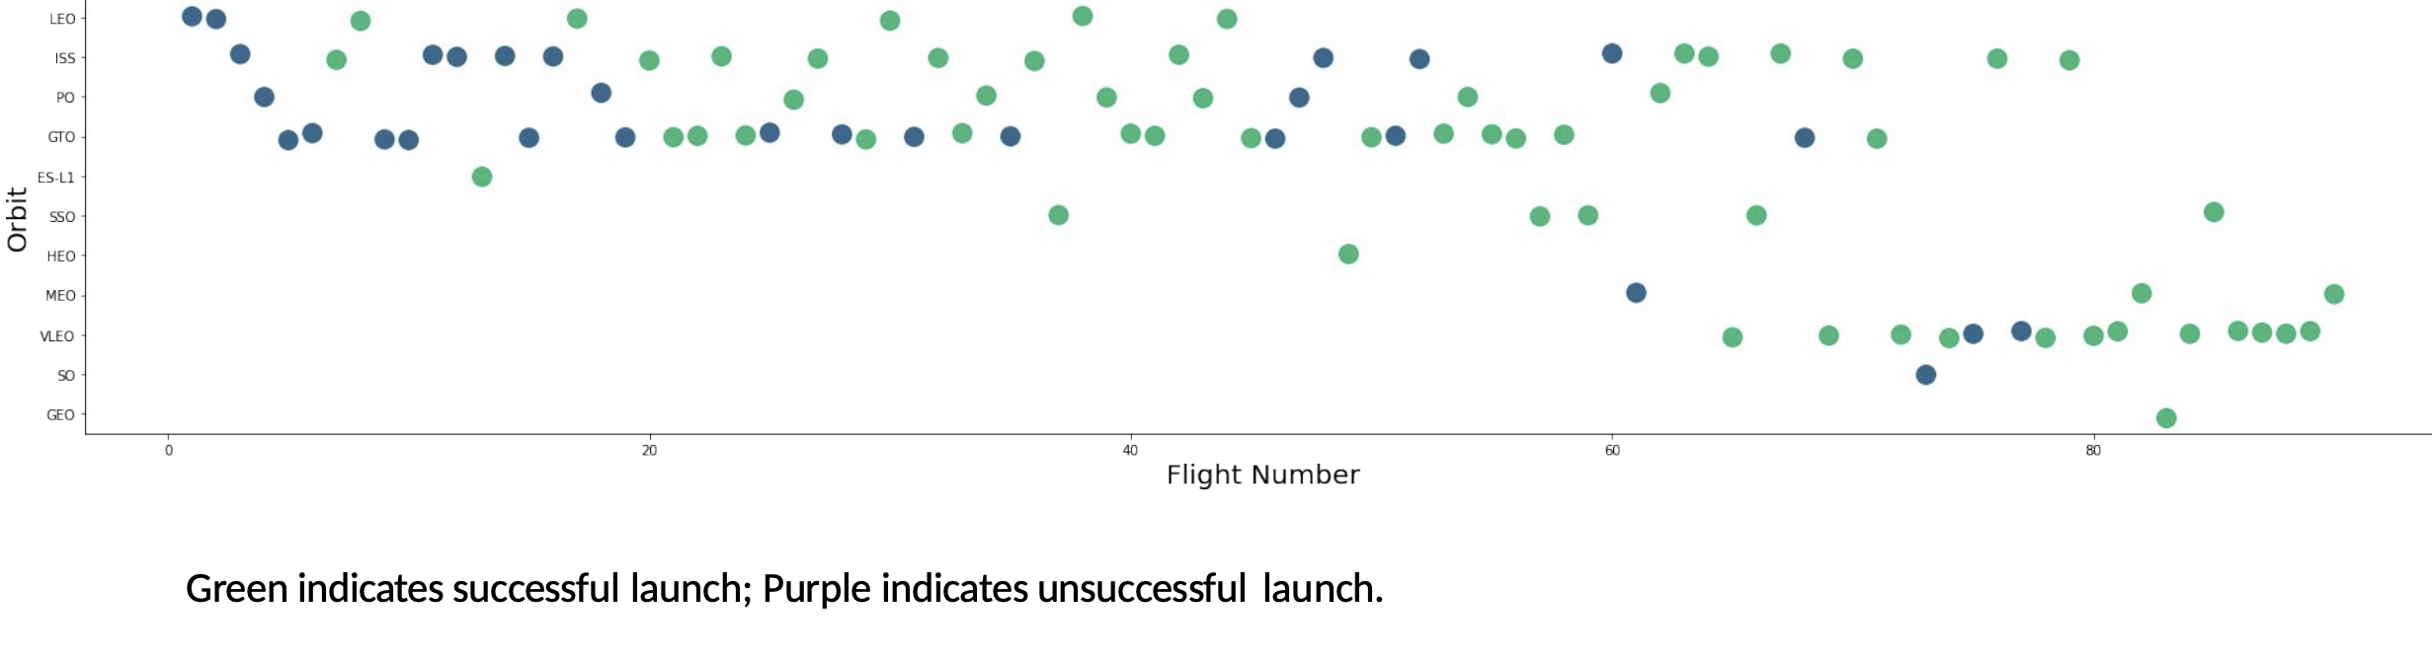
Flight Number vs. Orbit type

Slide 17
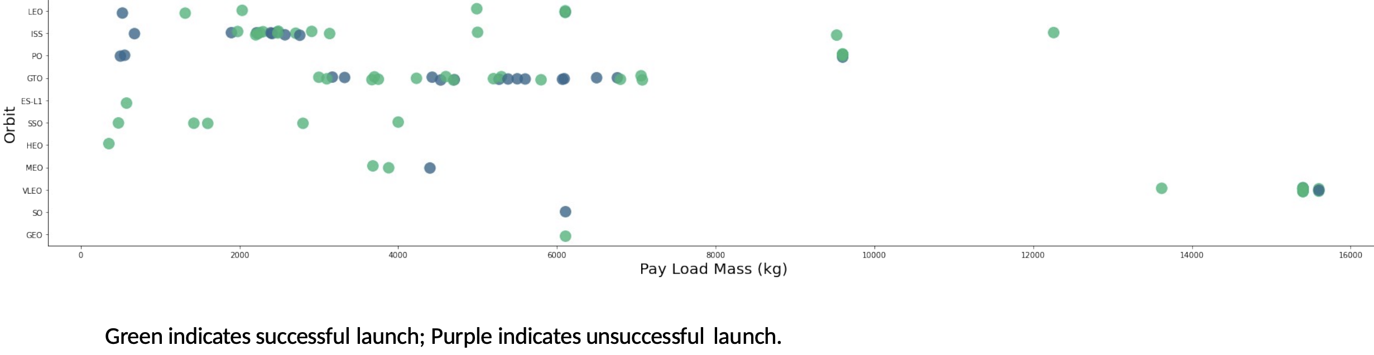
Payload vs. Orbit type

Slide 18
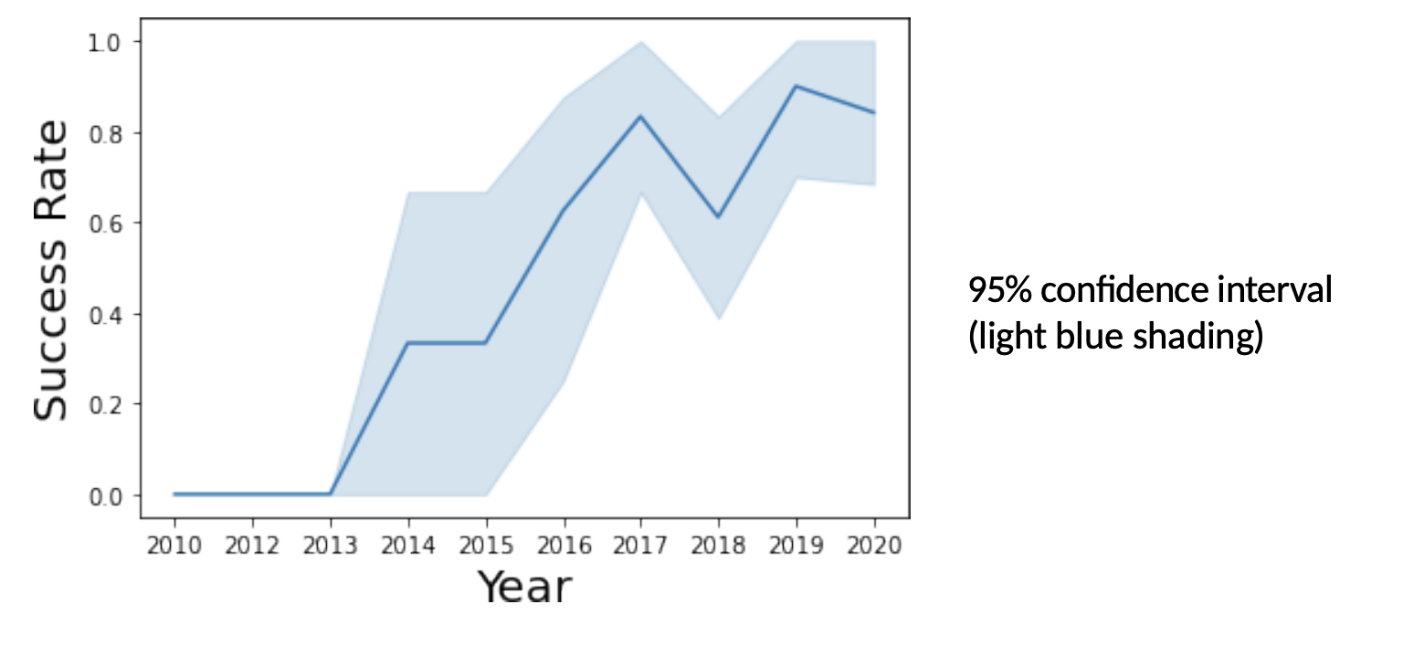
Launch Success Yearly Trend

Slide 19
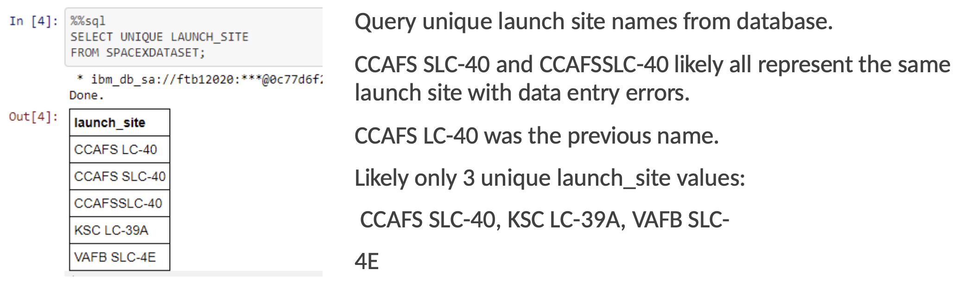
EDA with SQL

Slide 20
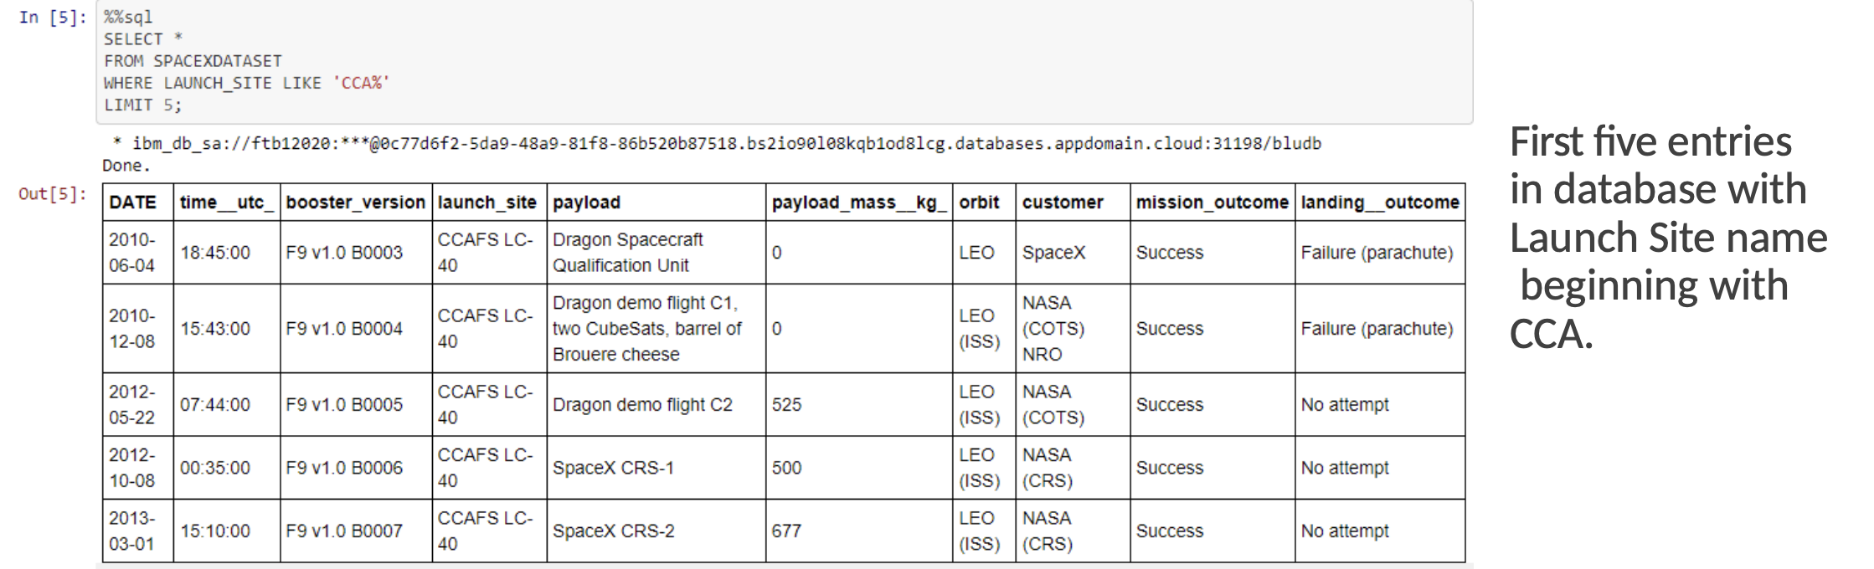
Launch Site Names Beginning with `CCA`

Slide 21
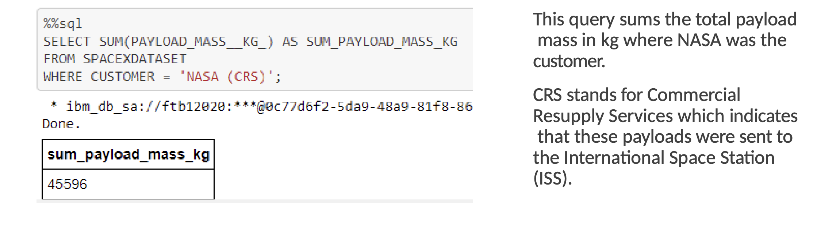
Total Payload Mass from NASA

Slide 22
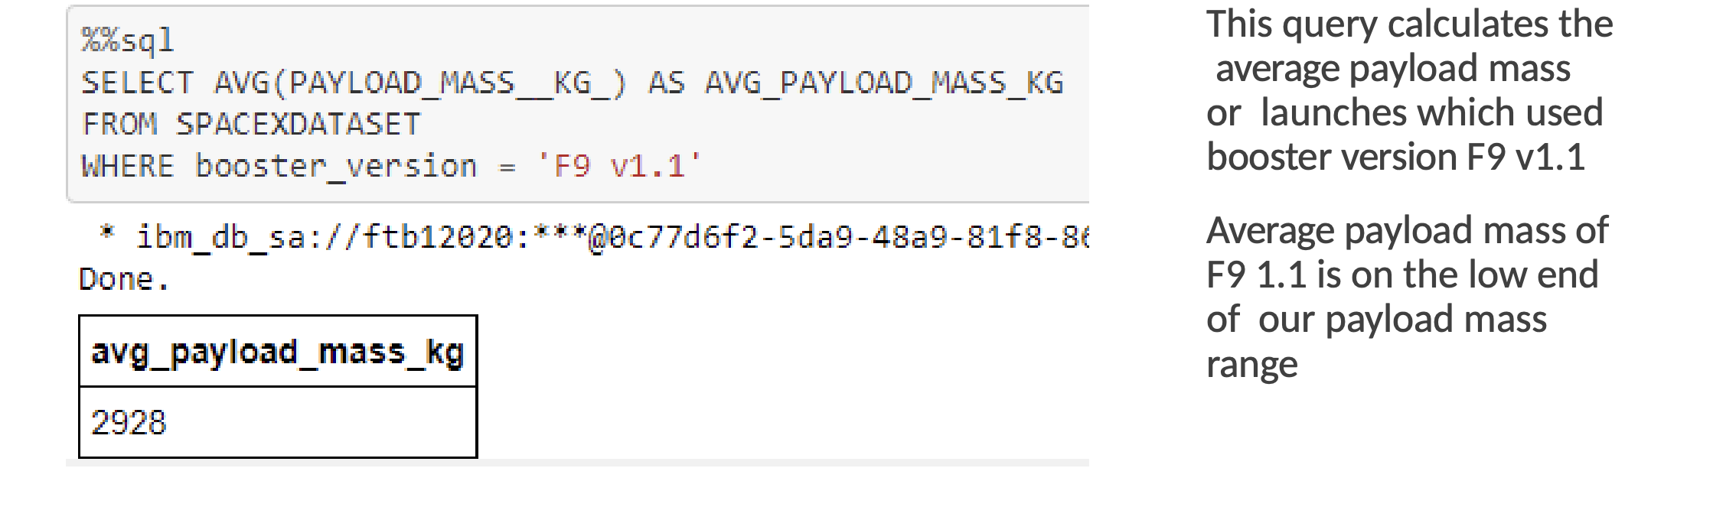
Average Payload Mass by F9 v1.1

